Slide 1
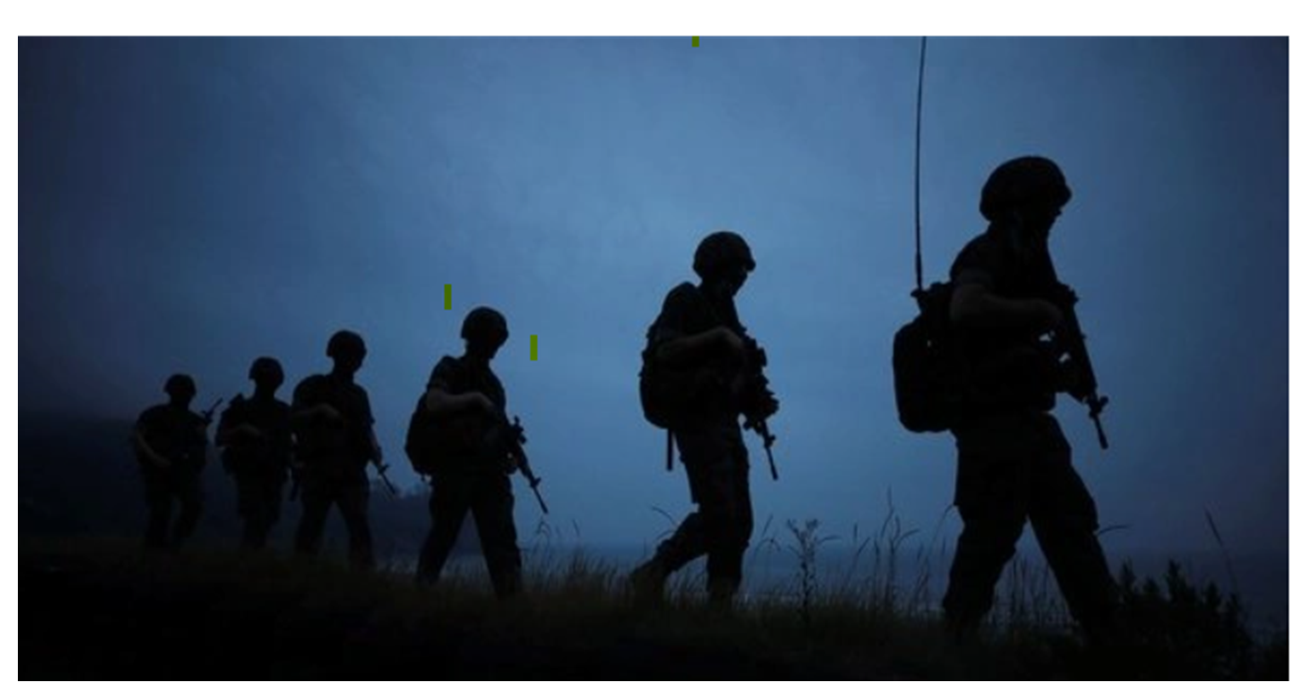


Slide 2


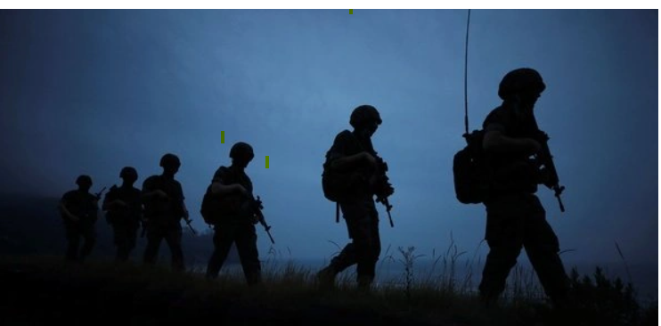
Market Volatility During International Conflicts
Presentation Rubrics (15 points)
Content
The presentation tells a story about the project and includes the following:
Selected topic
Reason topic was selected
Description of the source of data
Questions the team hopes to answer with the data
Description of the data exploration phase of the project
Description of the analysis phase of the project
Technologies, languages, tools, and algorithms used throughout the project
Slides
Presentations are drafted in Google Slides.
Group 1

Slide 3
Market Volatility During International Conflicts
Presentation Rubrics (15 points)
Content
The presentation tells a story about the project and includes the following:
Selected topic
Reason topic was selected
Description of the source of data
Questions the team hopes to answer with the data
Description of the data exploration phase of the project
Description of the analysis phase of the project
Technologies, languages, tools, and algorithms used throughout the project
Slides
Presentations are drafted in Google Slides.
Group 1

Slide 4
Market Volatility During International Conflicts
Reason topic was selected
Draft: With the current situation of Russia’s military invading Ukraine, our team has agreed and agreed to tackle an exploratory analysis on investor takes to war and uncertainty during international conflicts.
Group 1

Slide 5

Market Volatility During International Conflicts
Description of the source of data:
Stock Market data utilized from Kaggle:
https://www.kaggle.com/rishidamarla/stock-prices-over-a-30-year-period?select=DowJones.csv
International conflict database from Uppsala Conflict Data Program:
https://ucdp.uu.se/downloads/ucdpprio/ucdp-prio-acd-211.pdf
Other website resources:
https://www.investopedia.com/solving-the-war-puzzle-4780889
Group 1

Slide 6
Market Volatility During International Conflicts
Questions the team hopes to answer with the data
Does the size of the conflict have proportional impact?
Does the geographical location matter?
Are certain market segments impacted
Does the market bounce back after 90 days from the start of the conflict?
5. Which territory or location was greatly affected by and what was minimum, maximum and average market value during the conflict.
Group 1

Slide 7
Market Volatility During International Conflicts
Description of the data exploration phase of the project:
Data was downloaded from
Group 1

Slide 8
Market Volatility During International Conflicts
Description of the analysis phase of the project
Group 1

Slide 9
Market Volatility During International Conflicts
Description of the analysis phase of the project
Group 1

Slide 10

Group 1
Market Volatility During International Conflicts
Technologies, languages, tools, and algorithms used throughout the project
Appplications used:
Excel
Python
Postgres SQL/Pgadmin
Tools:
QuickDBD for ERD Diagram
Google Slides /Powerpoint
Algorithms:
Machine Learning/Neural Network

